Slide 1
RTC DISPLAY – COMPONENTS
Double layer PCB
DS1307 IC – RTC
74LC595 – shifter IC
74LC47 – LED 7 segments encoder
10/22/17
Copyrights 2016 UIT-Khoa KTMT . All Rights Reserved.

Slide 2
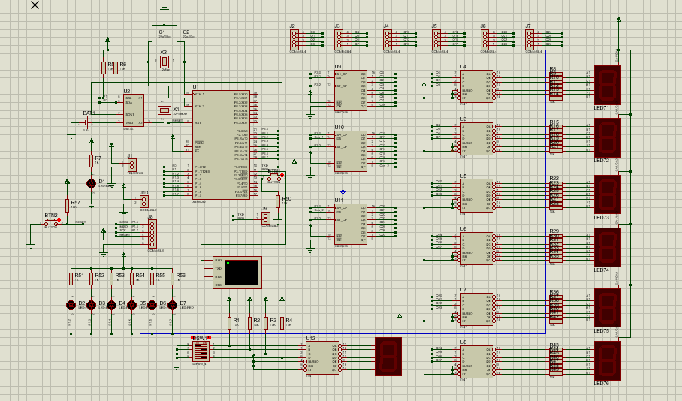
10/22/17
Copyrights 2016 UIT-Khoa KTMT . All Rights Reserved.

Slide 3
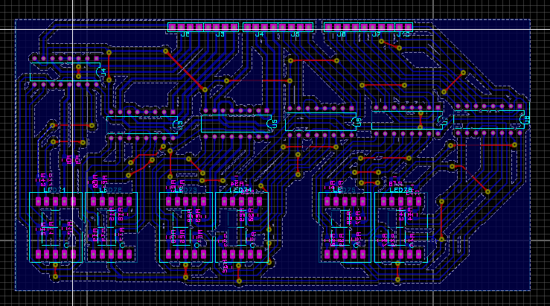
Display Layer
Upper layer
10/22/17
Copyrights 2016 UIT-Khoa KTMT . All Rights Reserved.

Slide 4
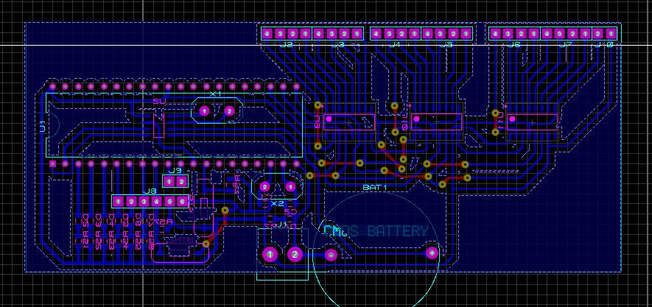
Processor Layer
Lower layer
10/22/17
Copyrights 2016 UIT-Khoa KTMT . All Rights Reserved.

Slide 5
RTC DISPLAY – SOFTWARE
Begin
Read HH:MM:SS from DS1307 using I2C
Shift bit with 74HC595 ( 24 bits)
Output to LED 7 segments
10/22/17
Copyrights 2016 UIT-Khoa KTMT . All Rights Reserved.

